Slide 1
נושאים מתקדמים בבסיסי נתונים
מרצה הקורס: ד"ר רוני שטרן
מתרגל: אלכס ציקינובסקי
בודק תרגלים: ?

Slide 2
נושאים כלליים
חובות:
  2 תרגילי בית (תכנות)
  20% מציון סופי
  פרויקט
  30% מציון סופי
  הגשה בזוגות
שעות קבלה:
  בתיאום מראש יום ראשון 20:00-19:00(מעבדה)
  E-mail: tsikinov@bgu.ac.il

Slide 3
נושאי התרגול
PL/SQL
JDBC
Hibernate
Cassandra
Redis
Map-Reduce
עבודה עם בסיסי נתונים מבוזרים

Slide 4
Tools & Languages
Java (jre 1.6)
Oracle 10g
Oracle SQL Developer
Eclipse Java EE IDE for Web Developers
(Juno Release)
Hibernate Tools
Cassandra 1.x
Redis 2.8

Slide 5
PL/SQL
Connection using Oracle SQL Developer
Main Features
Block Structure
Variables and Constants
Operations and Built In Functions

Slide 6
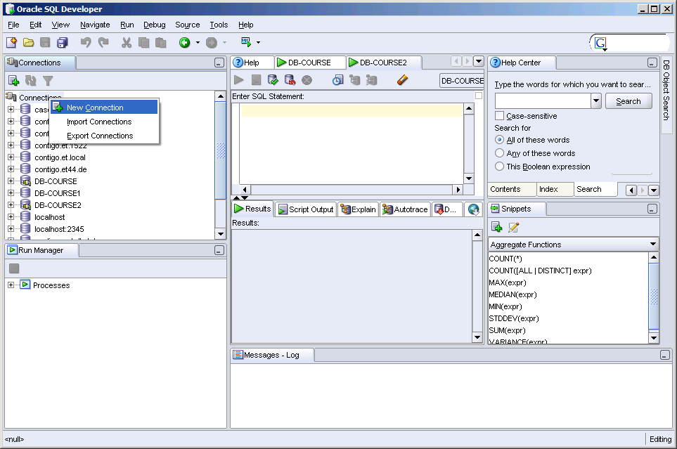
Connection using Oracle SQL Developer
Create a new connection

Slide 7
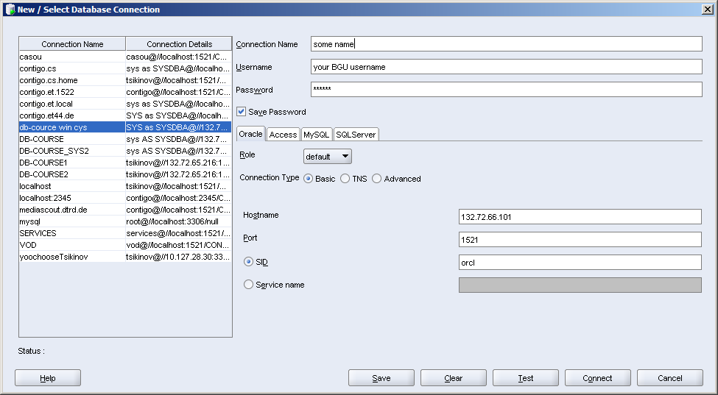
Connection using Oracle SQL Developer
Fill the required fields
Your university username
abcd, later you should change it.
Server IP
132.72.65.216
ora1.ise.bgu.ac.il
ora2.ise.bgu.ac.il
132.72.65.216
oracle
Oracle Port

Slide 8
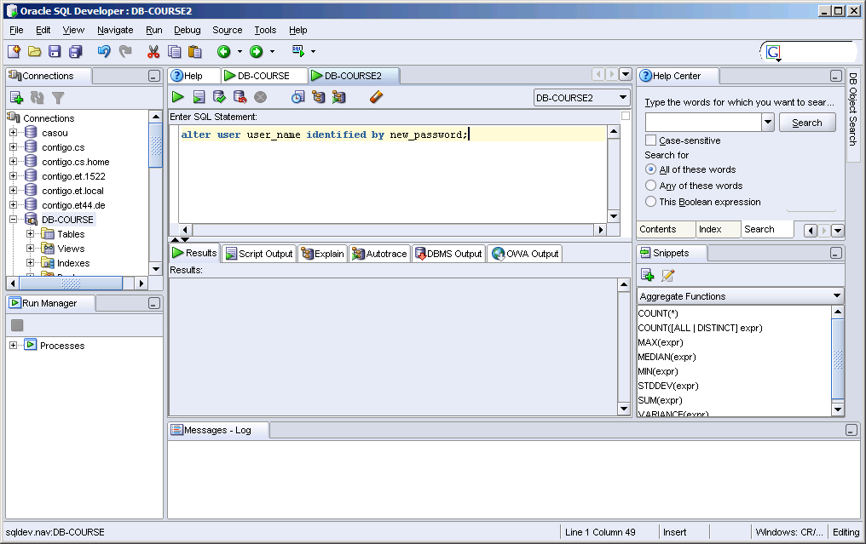
Connection using Oracle SQL Developer
To change the password type:
    alter user user_name identified by new_password

Slide 9
Main Features
בשפת PL\SQL אנו משתמשים בפקודות SQL כדי לשלוט בנתונים שבבסיס הנתונים ובפקודות זרם-שליטה(flow of control) כדי לעבד את הנתונים. יתרה מזאת, ניתן להצהיר על קבועים ומשתנים, להגדיר פרוצדורות ,פונקציות וטריגרים ולתפוס שגיאות. בכך PL\SQL משלבת את יכולות המניפולציה שלSQL עם יכולות העיבוד של שפה פרוצדוראלית.
כדי להבין איך נראית תכנית בשפת PL\SQL נתבונן על תכנית שמעדכנת את טבלת הרכישות ואת טבלת המלאי בעת קניית מחבט טניס:
-- this is a comment: First Example
DECLARE
qty_on_hand NUMBER(5);
BEGIN
SELECT quantity INTO qty_on_hand FROM inventory WHERE product = 'TENNIS RACKET'
FOR UPDATE OF quantity;
IF qty_on_hand > 0 THEN -- check quantity
UPDATE inventory SET quantity = quantity - 1 WHERE product = 'TENNIS RACKET';
INSERT INTO purchase_record VALUES ('Tennis racket purchased', SYSDATE);
ELSE
INSERT INTO purchase_record VALUES ('Out of tennis rackets', SYSDATE);
END IF;
COMMIT;
END;

Slide 10
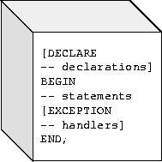
Block Structure
PL/SQL is a block-structured language.
  The basic units (procedures, functions, and anonymous blocks) that make up a PL/SQL program are logical blocks, which can contain any number of nested sub-blocks.
A block (or sub-block) lets you group logically related declarations and statements. That way, you can place declarations close to where they are used. The declarations are local to the block and cease to exist when the block completes.
A PL/SQL block has three parts: a declarative part, an executable part, and an exception-handling part. Only the executable part is required.

Slide 11
Variables and Constants
PL/SQL allows you to declare constants and variables, then use them in SQL and procedural statements anywhere an expression can be used. You must declare a constant or variable before referencing it in other statements, including other declarative statements.
Declaring Variables
Variables can have any SQL datatype, such as CHAR, DATE, or NUMBER, or any PL/SQL datatype, such as BOOLEAN or BINARY_INTEGER.
For example, assume that you want to declare a variable named part_no to hold 4-digit numbers, a string emp_name to hold up to 20 characters and a variable named in_stock to hold the Boolean value TRUE or FALSE. You declare these variables as follows:
Default setting: hours_worked INTEGER DEFAULT 40;
Not null setting: acct_id INTEGER(4) NOT NULL := 9999;
part_no NUMBER(4);
emp_name VARCHAR2(20);
in_stock BOOLEAN;

Slide 12
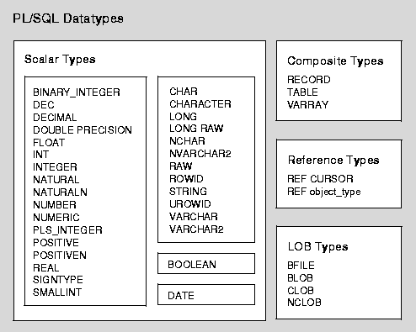
Datatypes
The LOB (large object) datatypes BFILE, BLOB, CLOB, and NCLOB let you store blocks of unstructured data (such as text, graphic images, video clips, and sound waveforms) up to four gigabytes in size. And, they allow efficient, random, piece-wise access to the data. LOBs support random access to data, while LONGs (and LONG RAW) support only sequential access. LOB types store values, called lob locators, that specify the location of large objects stored in an external file, in-line (inside the row) or out-of-line (outside the row). BFILE data is stored in operating system files outside the database.

Slide 13
Assigning Values to a Variable
You can assign values to a variable in two ways. The first way uses the assignment operator. You place the variable to the left of the operator and an expression to the right:
tax := price * tax_rate;
bonus := current_salary * 0.10;
amount := TO_NUMBER(SUBSTR('750 dollars', 1, 3));
valid := FALSE;
The second way to assign values to a variable is to select or fetch database values into it.
  In the following example, you have Oracle compute a 10% bonus when you select the salary of an employee:
SELECT sal * 0.10 INTO bonus FROM emp WHERE empno = emp_id;
Declaring Constants
Declaring a constant is like declaring a variable except that you must add the keyword CONSTANT and immediately assign a value to the constant. Thereafter, no more assignments to the constant are allowed.
credit_limit CONSTANT REAL := 5000.00;

Slide 14
Order of Operations
Operator | Operation
**, NOT *, / +, -, || =, <, >, <=, >=, <>, !=, ~=, ^=, IS NULL, LIKE, BETWEEN, IN AND OR | exponentiation, logical negation multiplication, division addition, subtraction, concatenation comparison conjunction inclusion

Slide 15
Built in functions
Error | Number | Character | Conversion | Date | Misc
SQLCODE SQLERRM | ABS ACOS ASIN ATAN ATAN2 CEIL COS COSH EXP FLOOR LN LOG MOD POWER ROUND SIGN SIN SINH SQRT TAN TANH TRUNC | ASCII CHR CONCAT INITCAP INSTR INSTRB LENGTH LENGTHB LOWER LPAD LTRIM NLS_INITCAP NLS_LOWER NLSSORT NLS_UPPER REPLACE RPAD RTRIM SOUNDEX SUBSTR SUBSTRB TRANSLATE TRIM UPPER | CHARTOROWID CONVERT HEXTORAW RAWTOHEX ROWIDTOCHAR TO_CHAR TO_DATE TO_MULTI_BYTE TO_NUMBER TO_SINGLE_BYTE | ADD_MONTHS LAST_DAY MONTHS_BETWEEN NEW_TIME NEXT_DAY ROUND SYSDATE TRUNC | BFILENAME DECODE DUMP EMPTY_BLOB EMPTY_CLOB GREATEST LEAST NLS_CHARSET_DECL_LEN NLS_CHARSET_ID NLS_CHARSET_NAME NVL SYS_CONTEXT SYS_GUID UID USER USERENV VSIZE

Slide 16
Some Syntax and functions
We represent strings (type CHAR) by enclosing them with single quotes: ’bla bla’
We represent ‘ by two single quotes inside a string: ‘don’’t bla bla’
Null represents a missing value (IF variable IS NULL THEN ...)
Comments:
  Single line: --this is a single line comment
  Multi lines: /* this is a
  multi lines comment*/
Like: ename LIKE 'J%SON'
  An underscore (_) matches exactly one character; a percent sign (%) matches zero or more characters.
Between: 45 BETWEEN 38 AND 44
In: DELETE FROM emp WHERE ename IN (NULL, 'KING', 'FORD');
Double vertical bars (||) serve as the concatenation operator, which appends one string to another: 'suit' || 'case‘ ➔ 'suitcase‘
DECODE: SELECT DECODE(rating, NULL, 1000, 'C', 2000, 'B', 4000, 'A', 5000) INTO credit_limit FROM accts WHERE acctno = my_acctno; → acts like a case statement: for rating = null, c, b and a the value that follows the rating case is returned.
The function NVL returns the value of its second argument if its first argument is null: start_date := NVL(hire_date, SYSDATE);
Replace: REPLACE('Gold-i-locks', '-', NULL);➔ 'goldilocks'
Printing output on screen: DBMS_OUTPUT.PUT_LINE(num_changed);

Slide 17
Conditional Control
התוכנית הבאה מטפלת בטרנזקציות בנקאיות. לפני שהיא מאפשרת לך למשוך 500$ מחשבון מס' 3, היא מוודא שיש בחשבון זה יתרה מספקת. אם יש יתרה מספקת התכנית מחיבת את החשבון בסכום המבוקש, אחרת התכנית מוסיפה רשומה לטבלת ביקורת חשבונות.
DECLARE
acct_balance NUMBER(11,2);
acct CONSTANT NUMBER(4) := 3;
debit_amt CONSTANT NUMBER(5,2) := 500.00;
BEGIN
SELECT bal INTO acct_balance FROM accounts WHERE account_id = acct FOR UPDATE OF bal;
IF acct_balance > debit_amt THEN
UPDATE accounts SET bal = bal - debit_amt WHERE account_id = acct;
ELSIF acct_balance = debit_amt THEN
UPDATE accounts SET bal = bal - debit_amt WHERE account_id = acct;
INSERT INTO temp VALUES(acct, 0, 'Account is empty');
-- insert account, current balance, and message
ELSE
INSERT INTO temp VALUES(acct, acct_balance, 'Insufficient funds');
-- insert account, current balance, and message
END IF;
COMMIT;
END;

Slide 18
תרגילון מס' 1
צור בבסיס הנתונים טבלה בשם results המכילה שדה מספרי בשם difference ושני שדות טקסט באורך של עד 10 תוים, האחד מייצג זמן התחלה והשני זמן סיום.
כתוב בלוק בשפת pl/sql המודד זמן התחלה של התוכנית, מדפיס אותו לאחר מכן, מודד זמן נוכחי של המערכת ומכניס על שני משתני מחרוזות (start_time ו finish_time ) את הערכים המייצגים כמות שניות לאחר חצות של כל זמן שנמדד. (היעזר בפקודה to_char(date, format) ובפונקציה sysdate)
התוכנית מחשבת את ההפרש בין שני המשתנים ומעדכנת את הזמנים ואת ההפרש בטבלה results .

